Slide 1
Movie predictions: genre runtime sales
Notes:
Brayden

Slide 2
AGENDA
Introduction
Data Set Explanation
Data Cleaning
Hypothesis Testing
Linear Regression
Logistic Regression
Conclusion
Notes:
Brayden

Slide 3
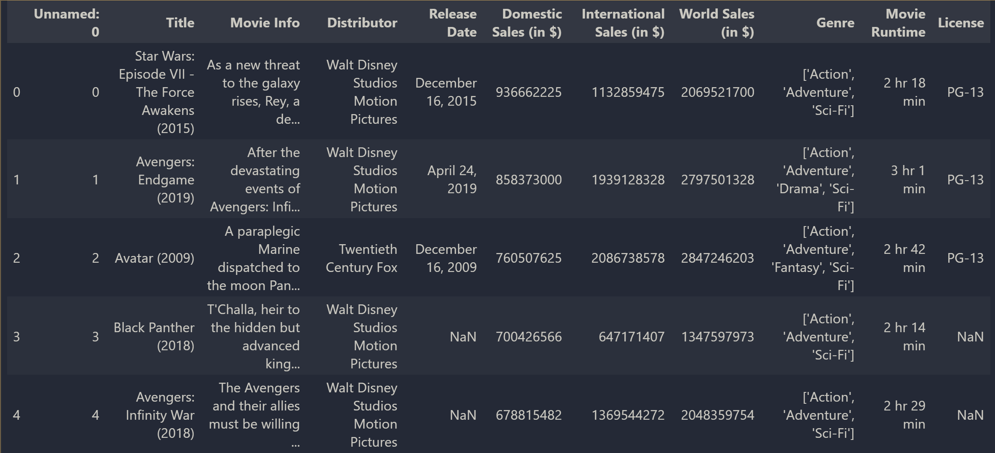
Data set explanation
Data Set: Hollywood Highest Grossing Films (918 Movies, 10 Columns)
Notes:
Brayden

Slide 4
Data cleaning
Movie runtime in minutes
Genre separation
Action vs. Non-Action
Notes:
Justin

Slide 5
HYPOTHESIS statement
Hypothesis Statement: There is a significant difference in the sales of action movies compared to the global sales of non-action movies.
Why?
Inferred action movies would gross more over non-action
Decision to compare and test
Result
There is a significant difference in world sales of action movies vs. movies with no action
Action Movies make more
Notes:
Jeremy

Slide 6
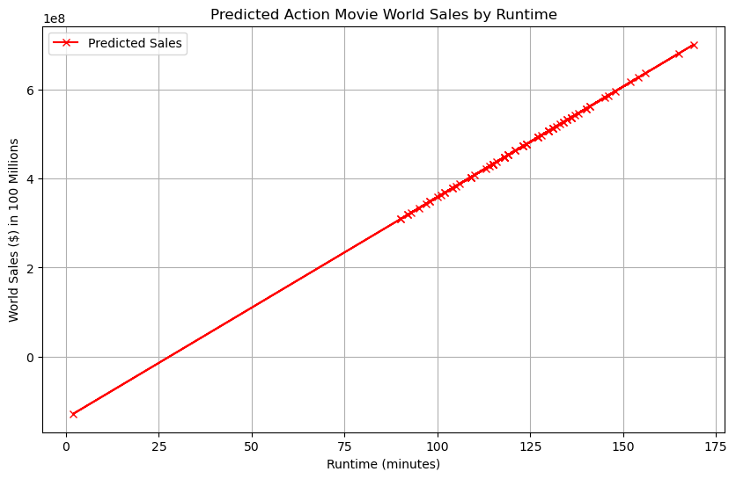
Linear regression
Notes:
Chris

Slide 7
Logistic regression
Result
Hard to accurately predict if a movie was an action movie or not, strictly based on its global sales and runtime
Notes:
Was movie classified as action or comedy (as action/comedy or not comedy/action). Predict genre based off sales or runtime. Zeros and Ones.
Hard to accurately predict if a movie was an action movie or not, strictly based on its global sales

Slide 8
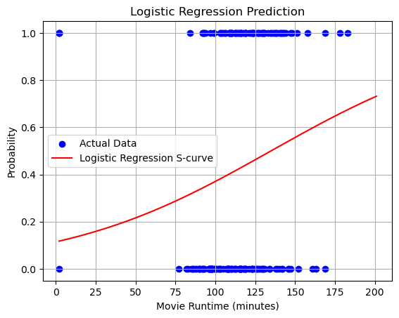
Logistic regression
Notes:
Was movie classified as action or comedy (as action/comedy or not comedy/action). Predict genre based off sales or runtime. Zeros and Ones.
Hard to accurately predict if a movie was an action movie or not, strictly based on its global sales

Slide 9
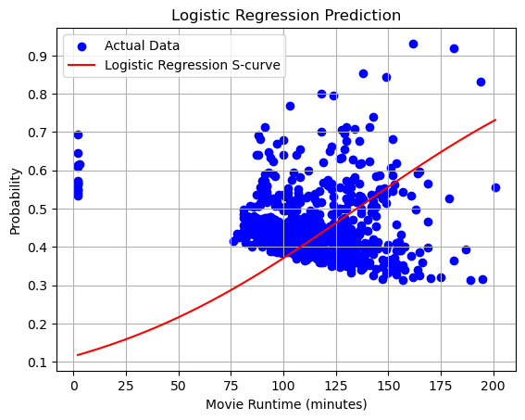
Logistic regression
Notes:
Was movie classified as action or comedy (as action/comedy or not comedy/action). Predict genre based off sales or runtime. Zeros and Ones.
Hard to accurately predict if a movie was an action movie or not, strictly based on its global sales

Slide 10
Questions? Comments?

